Slide 1
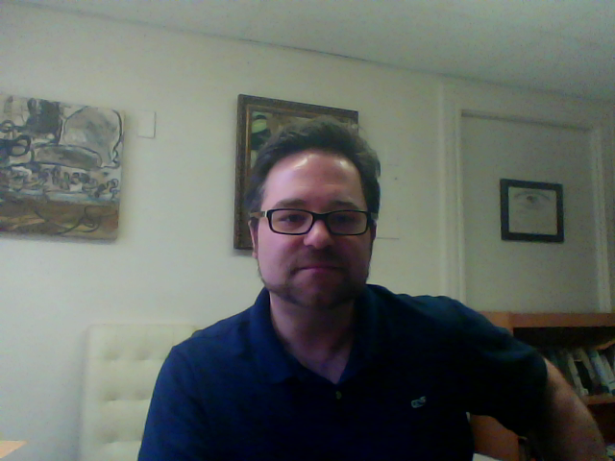
HUSB 143 Contemporary American Literature
Essay #2: “Thesis” Writing
Thesis: A central interpretive claim
Good thesis must be:
-- Arguable
-- Based on evidence from the text
-- Opens up new avenues or understanding of the text for readers

Slide 2
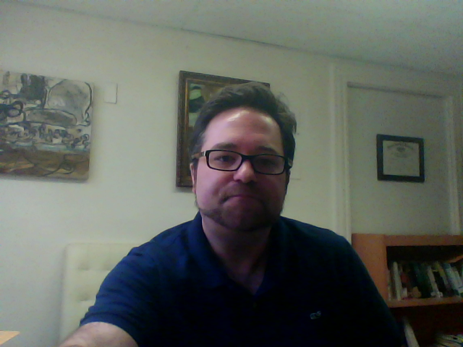
HUSB 143 Contemporary American Literature
Essay #2: “Thesis” Writing
What should I do if I can’t come up with an idea?
-- Re-read your favorite text so far, looking for moments or aspects of the text that
invite our thinking
-- Review our discussion boards, looking for an ongoing debate that you can join; look
for interpretations that make you think “No! That’s not how I see it…”

Slide 3
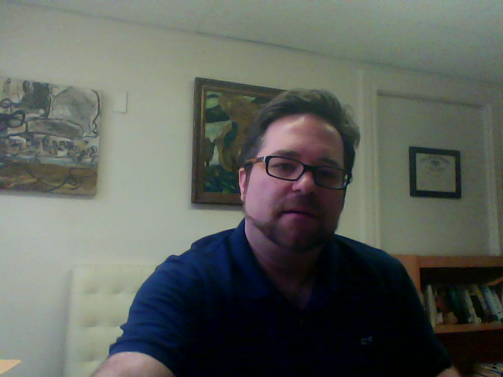
HUSB 143 Contemporary American Literature
Essay #2: “Thesis” Writing
Once you have an idea:
-- Build a list of passages/moments in the text in which your idea is important (if you’re writing
about the “gun” in “The Man Who Was Almost A Man,” you’ll want to re-read closely the passages discussion the gun).
Structuring the essay (just a suggestion!)
-- Intro paragraph sets up the “issue”
-- Last sentence of intro paragraph is your thesis
-- Each paragraph that follows should help build your case by providing and examining passages in the text that support your view.

Slide 4
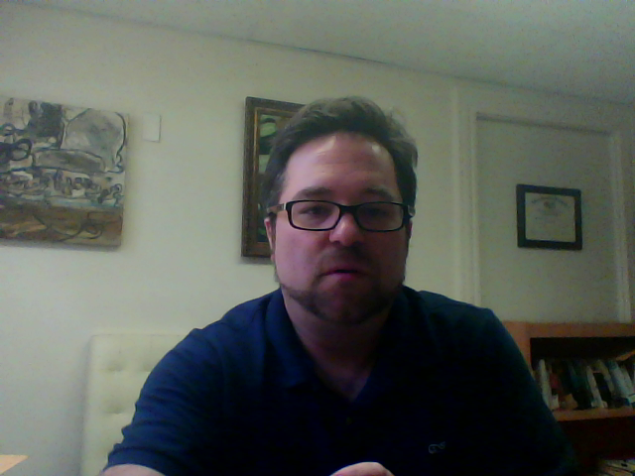
HUSB 143 Contemporary American Literature
Essay #2: “Thesis” Writing
Reminder:
Please contact your instructor if you need help coming up with a topic. This is the most challenging assignment of the term.

